Slide 1

Online Book Store
Things to know about our project!
Batch: Faculty: Co-ordinator :
|| 2210B3 || Ebad-Uddin Ahmed || Munazzah ​​​​​

Slide 2

Project Group Member :
STUDENT ID
STUDENT NAME
Student1419861
Alishba Hashmi
Student1421223
Rabia Kanwal
Student1419864
Talha Shehzore Khan

Slide 3
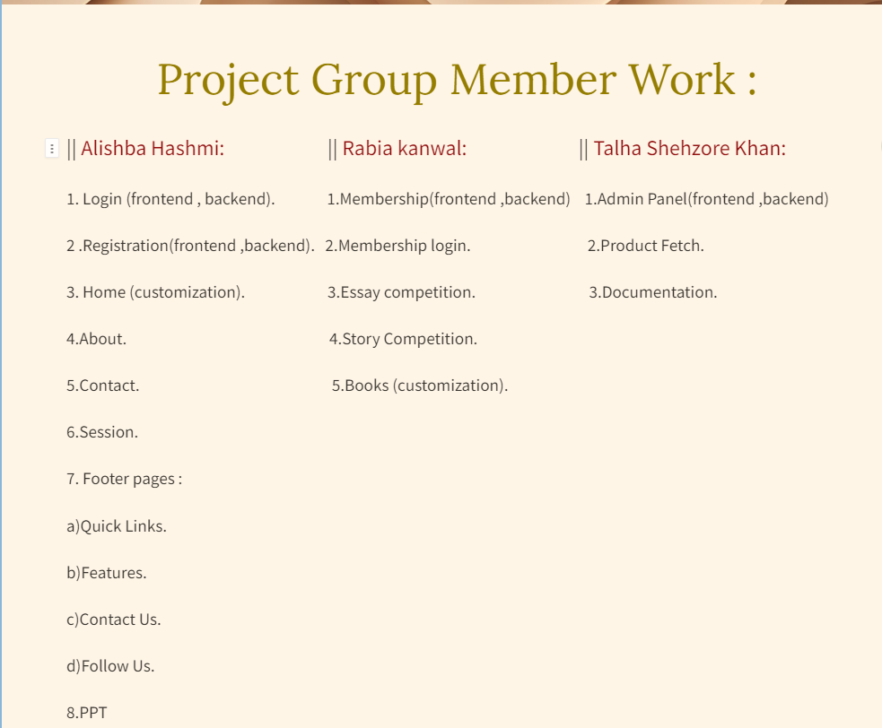
b)Features.
c)Contact Us.
d)Follow Us.
8.PPT

Slide 4


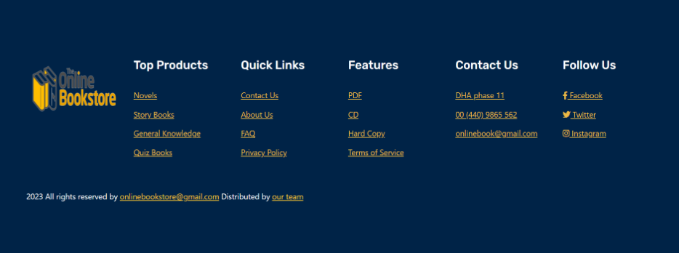
Login page :

Slide 5
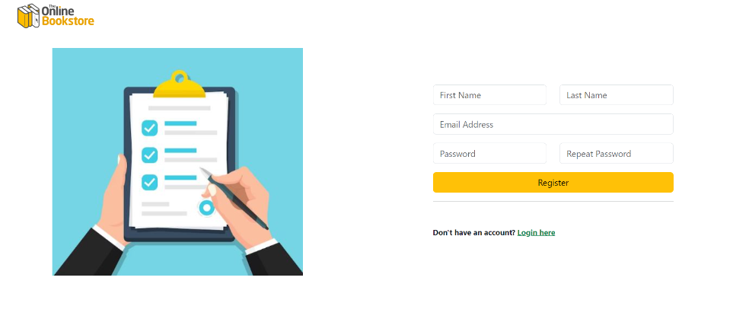

Registration page :

Slide 6


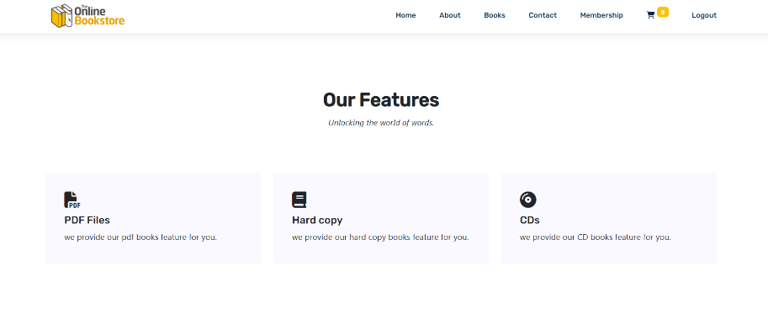
Home page :

Slide 7

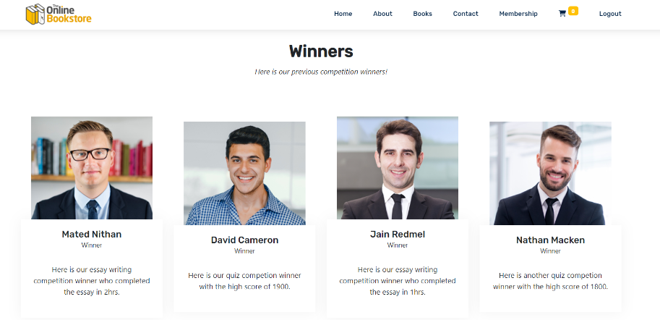


Slide 8
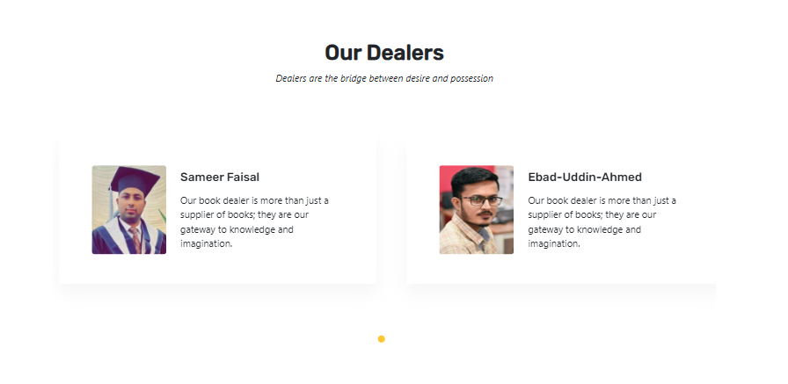

...

Slide 9

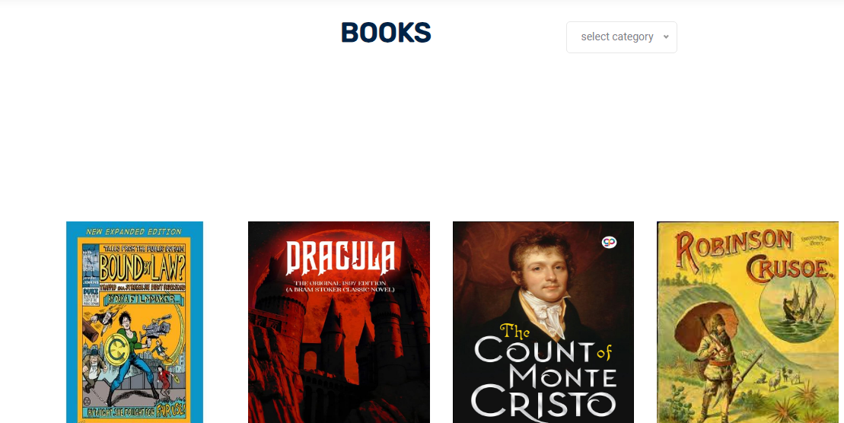
Books Categories :
...

Slide 10
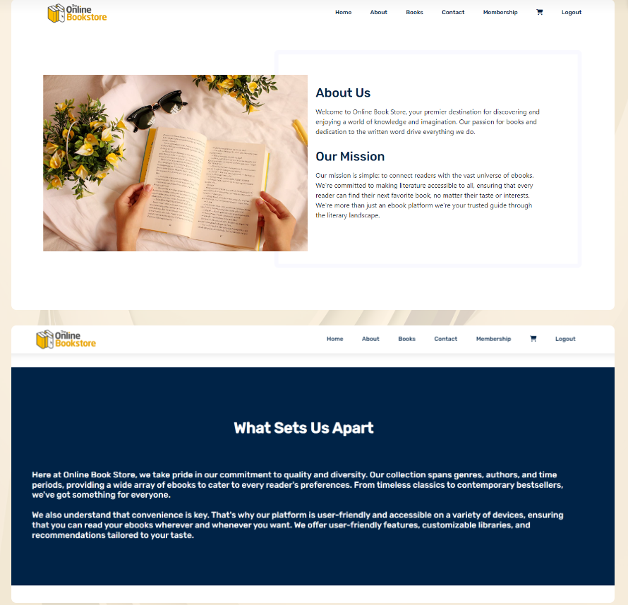
About Us :
Loading...

Slide 11
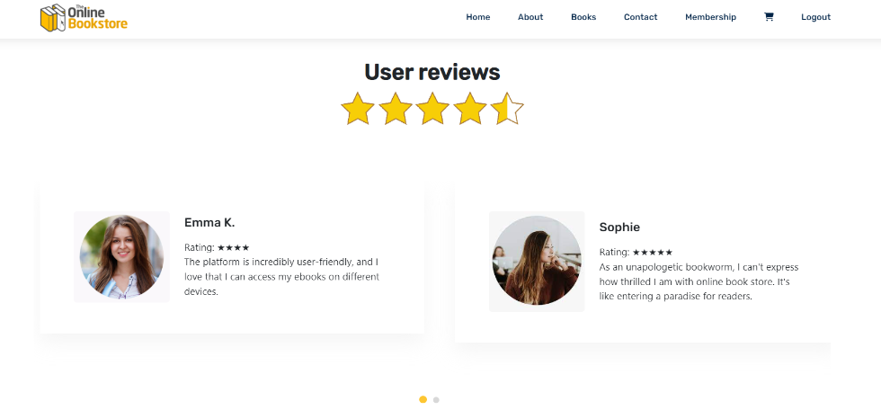


Slide 12

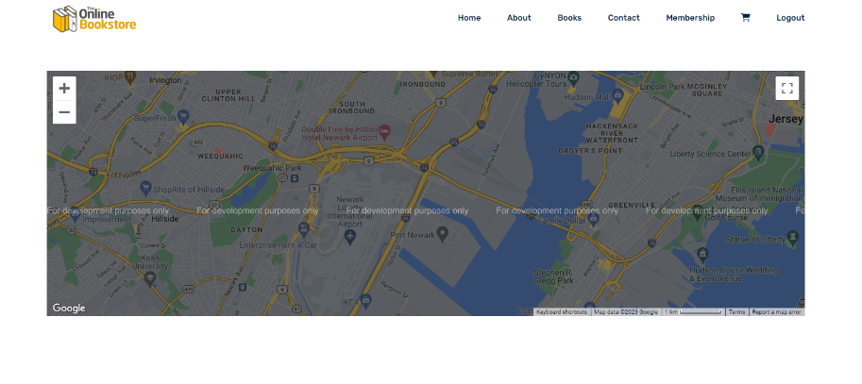
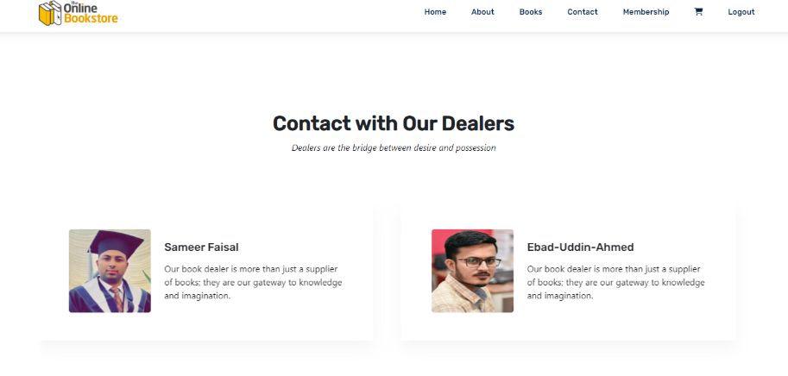
Contact Us :

Slide 13

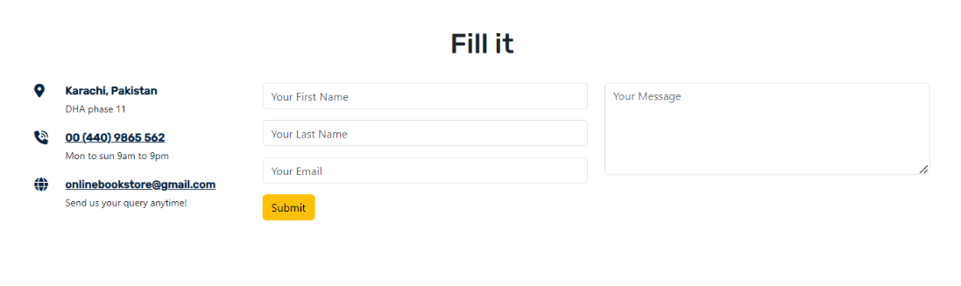


Slide 14
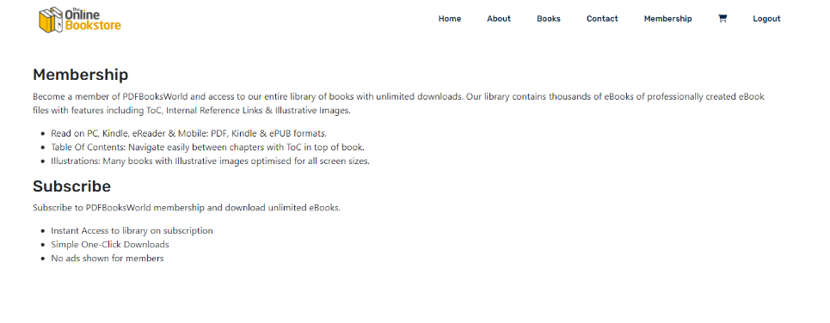

Membership :

Slide 15
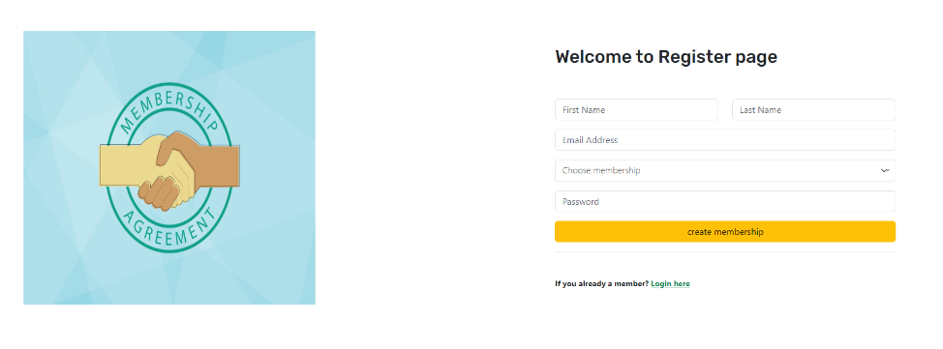
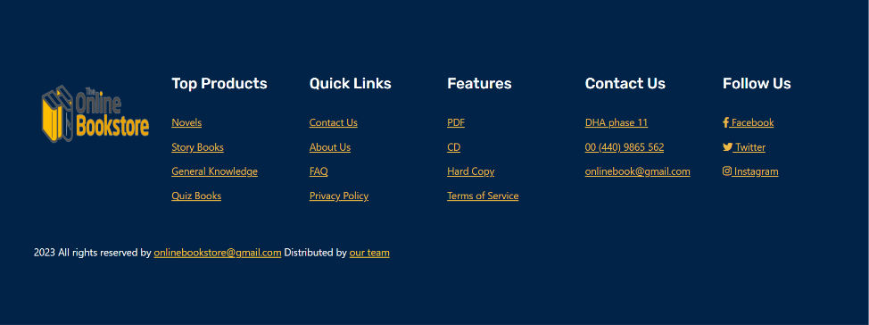

Slide 16


Membership Login :

Slide 17

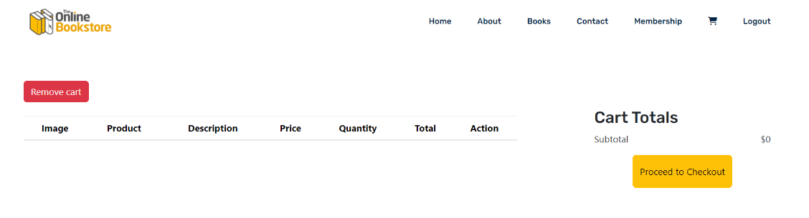

Add To Cart :

Slide 18

Thanks For Watching!

